Slide 1
Enhancing Security in Shared Source Code Repositories: Best Practices and Strategies
Protecting codebases through effective collaboration safeguards

Slide 2
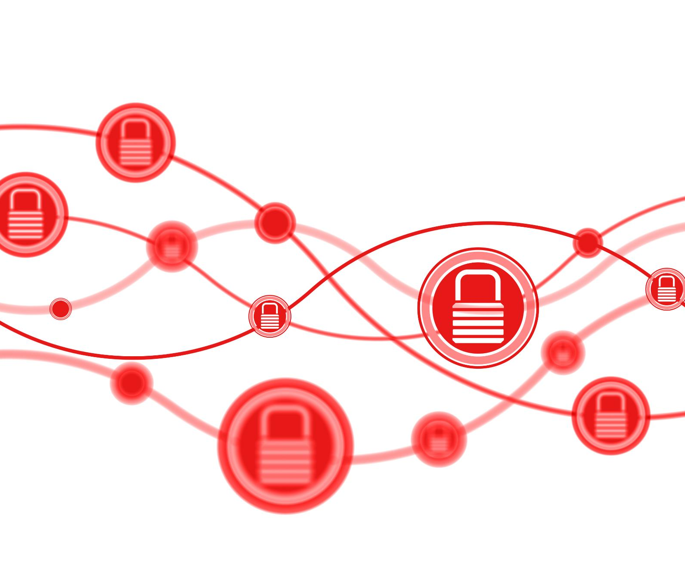
Introduction to Shared Source Code Repositories
Collaborative Development
Shared repositories allow multiple developers to work simultaneously on the same codebase, enhancing productivity and innovation.
Security Challenges
Shared repositories can expose code to unauthorized access and increase vulnerability risks if not properly secured.
Development Lifecycle Role
Understanding repository workflows is essential for integrating security controls throughout the software development lifecycle.

Slide 3

Common Security Risks in Shared Repositories
Unauthorized Access
Shared repositories are vulnerable to unauthorized access compromising the integrity of code and data.
Malicious Code Injection
Injection of malicious code can corrupt projects and introduce security vulnerabilities.
Exposure of Sensitive Data
Sensitive information in repositories can be exposed if not properly protected.
Insufficient Auditing
Lack of proper auditing reduces the ability to detect and respond to security breaches.

Slide 4
Authentication and Access Management
Strong Authentication Methods
Multi-factor authentication adds layers of security by requiring multiple verification steps from users.
Role-Based Access Control
Role-based access control ensures users can only access data and functions relevant to their role.
Permission Review
Regularly reviewing and updating permissions helps minimize security risks and reduce potential attack surfaces.

Slide 5

Code Review Processes and Policies
Rigorous Review Policies
Establishing strict code review policies improves security and maintains high quality standards.
Peer Reviews
Peer reviews enable early detection of issues by involving multiple developers in the review process.
Automated Checks
Automated tools help identify vulnerabilities and maintain repository integrity efficiently.

Slide 6

Automated Security Scanning Tools
Code Vulnerability Scanning
Automated tools scan source code to detect common security vulnerabilities effectively and quickly.
Dependency Security Checks
Tools identify insecure or outdated dependencies to prevent supply chain security risks.
Policy Violation Detection
Automated scanning ensures compliance by detecting policy violations during development.
Integration in Dev Pipeline
Integrating scanning tools into development pipelines enables proactive security issue resolution.

Slide 7
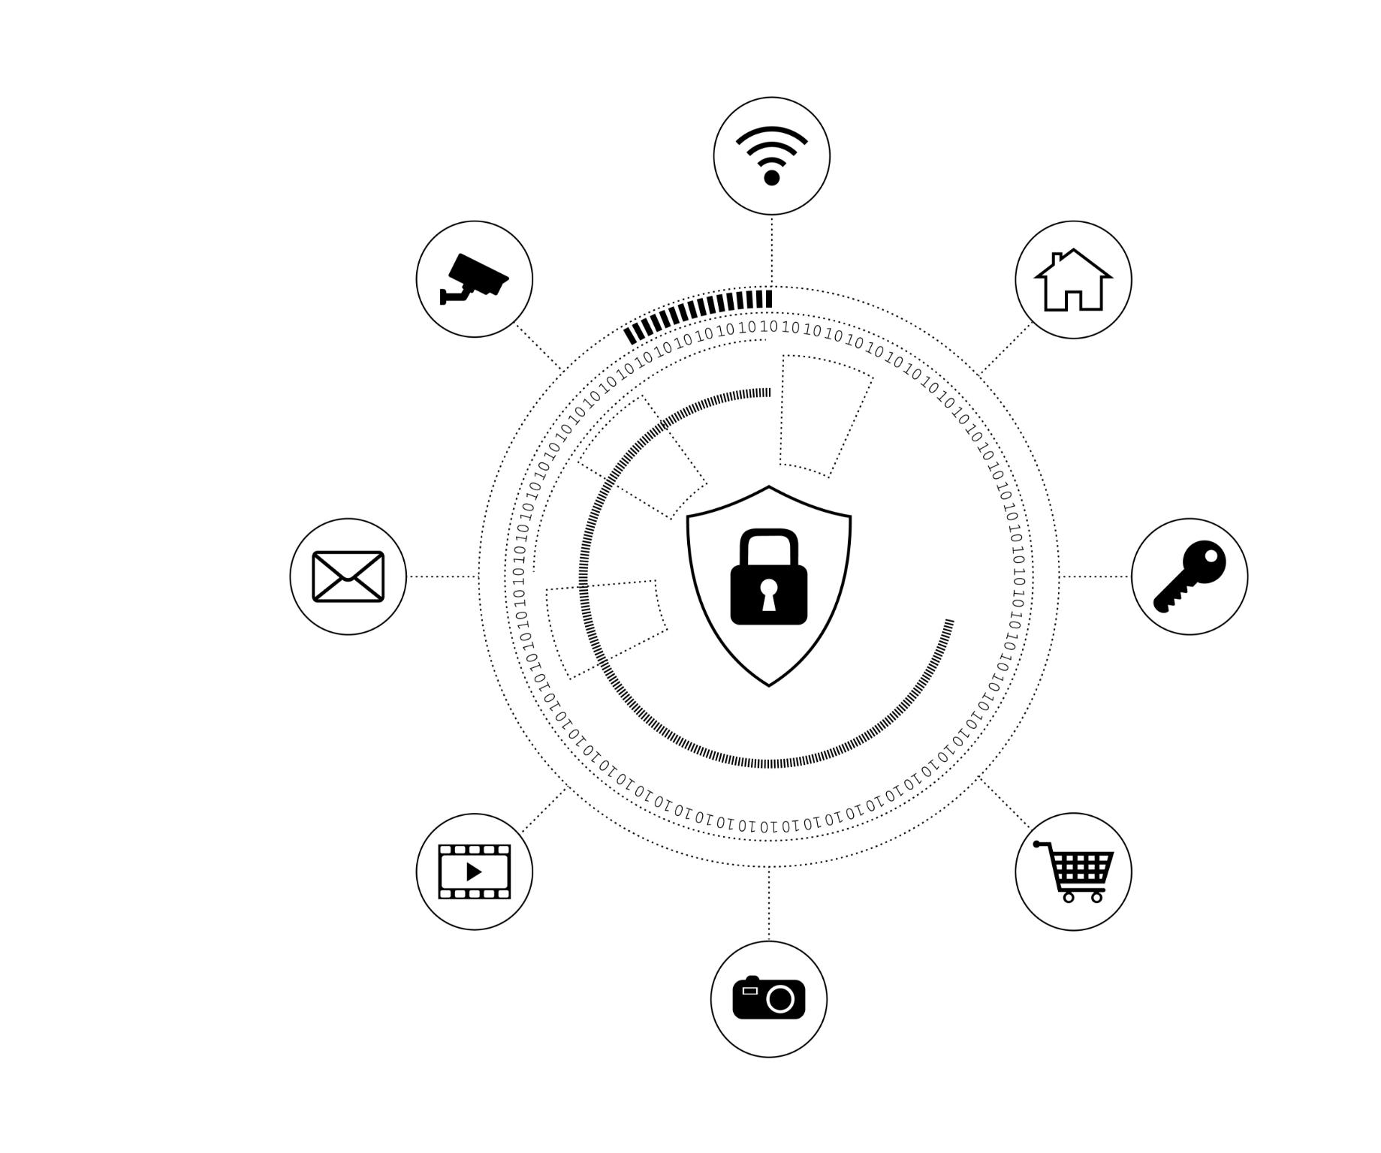
Managing Secrets and Sensitive Data
Avoid Hardcoding Secrets
Never embed passwords or API keys directly in source code to prevent security risks.
Use Secure Vaults
Store sensitive data securely using vaults or environment variables to safeguard access.
Implement Scanning Tools
Utilize scanning tools to detect accidental exposure of secrets within code repositories.

Slide 8
Training and Best Practices for Contributors
Secure Coding Education
Teaching contributors secure coding practices reduces vulnerabilities and strengthens software security.
Repository Policy Awareness
Clear repository policies guide contributors to maintain code quality and security standards.
Threat Awareness and Vigilance
Regular training fosters awareness of common threats to ensure ongoing vigilance and compliance.

Slide 9
Conclusion
Technical Controls
Implementing robust technical controls strengthens protection mechanisms in shared code repositories.
Policy Implementation
Establishing clear policies guides secure contributions and enforces best practices throughout development.
Contributor Education
Ongoing education empowers contributors to follow security best practices and reduce risks.

Slide 10
References
Fernandes, C. (2025, November 13). Source code security best practices: A complete guide: Blog. Assembla. https://get.assembla.com/blog/source-code-security
GitHub. (2025). Quickstart for Securing Your Repository. GitHub Docs. https://docs.github.com/en/code-security/getting-started/quickstart-for-securing-your-repository
Harness. (2025, November 5). Best practices for securing code repositories. Harness.io. https://www.harness.io/harness-devops-academy/secure-code-repositories-best-practices
Rose, J. (2025, July 24). 12 best practices for Secure Code Repositories (2025 guide). Checkmarx. https://checkmarx.com/supply-chain-security/repository-health-monitoring-part-2-essential-practices-for-secure-repositories
Tal, L. (2023, November 16). Securing source code in repositories is essential: How to get started. Snyk. https://snyk.io/articles/securing-source-code-repositories
(no attribution required for Microsoft 365 stock image gallery images)

